Slide 1



Mantid
Manipulation and Analysis Toolkit for ISIS data
Nick Draper
05/11/2008

Slide 2
Project Aims
Aims
  To provide a framework for Data Analysis that is not instrument or technique/dependent.
  Support multiple target platforms (Windows, Linux).
  Easily extensible by Instruments Scientists/Users.
  Freely redistributable to visiting scientists.
  Provide low-level functionalities for
    Scripting
    Visualization
    Data transformation
    Implementing Algorithms
    Virtual Instrument Geometry

Slide 3
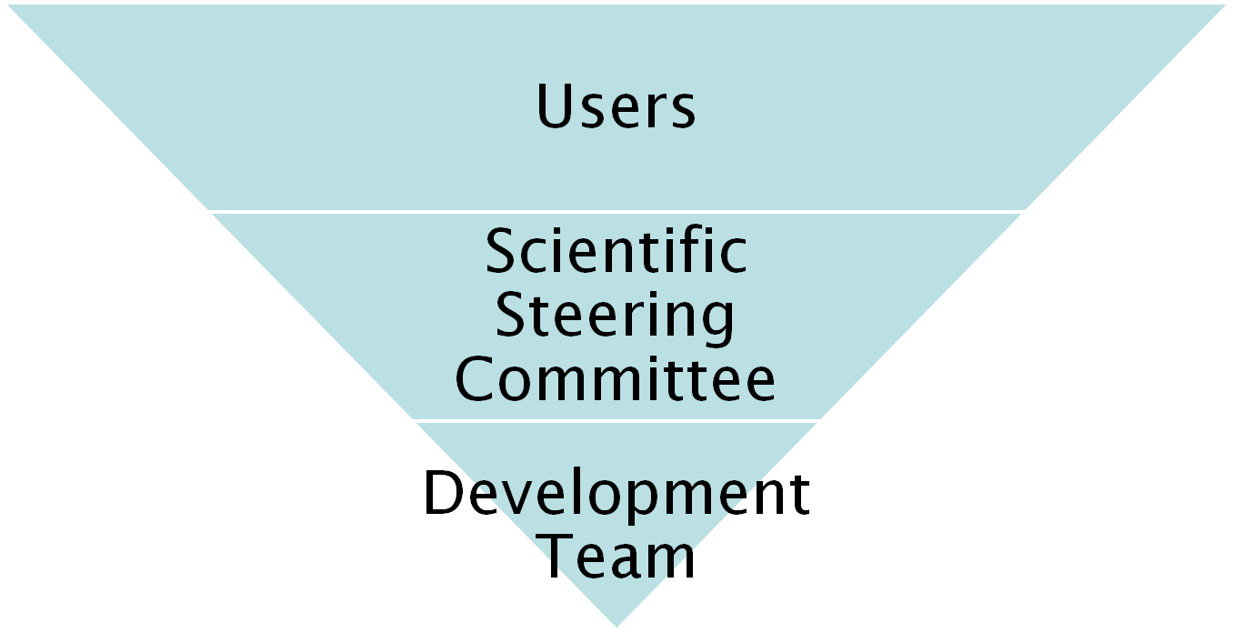
Project Organisation
27 beamlines, 1600 users
9 Key scientists representing every beamline.
PM &
7 Developers

Slide 4
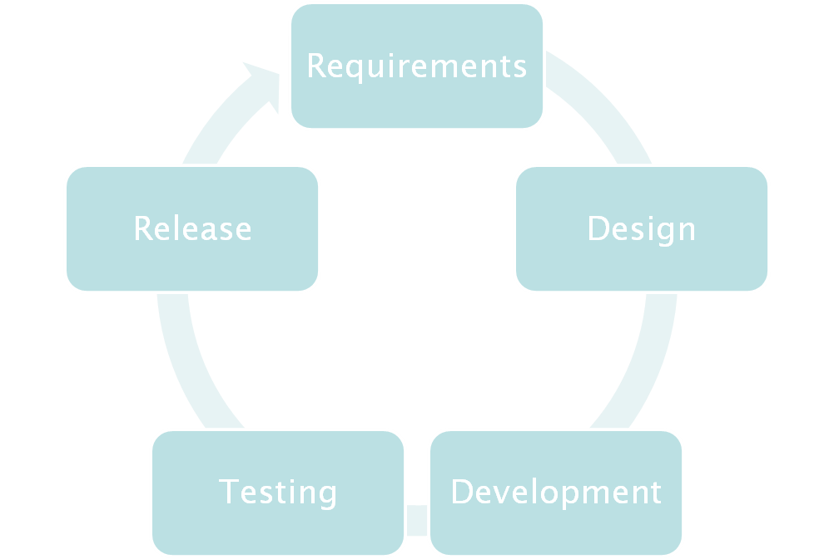

Iterative Development Process

Slide 5
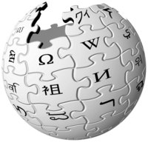
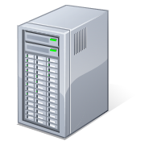

Continuous Integration Environment
Mantid Project Wiki
SVN
Repository
Linux Build Server
trac
Issue
tracking
system
Windows Build Server
Developers

Slide 6
Design Criteria
Separation of Data and Algorithms
Encapsulated “User Code” in specific places
  Algorithms
  Workspaces
Use of well designed interfaces to allow generic use of components
Reuse of existing components
Careful memory management when handling large datasets

Slide 7
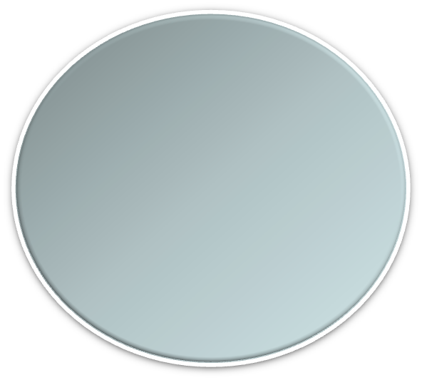


Architectural Design - Overview
Instrument log files
MantidScript
Command line & Scripting interface
RAW data files
Mantid Framework
API
Algorithms
Workspaces
MantidPlot Graphing and analysis
NEXUS data files
User Defined
User Defined
Matlab Interface
DAE direct access
Future Instrument specific UI
Future Instrument specific UI

Slide 8
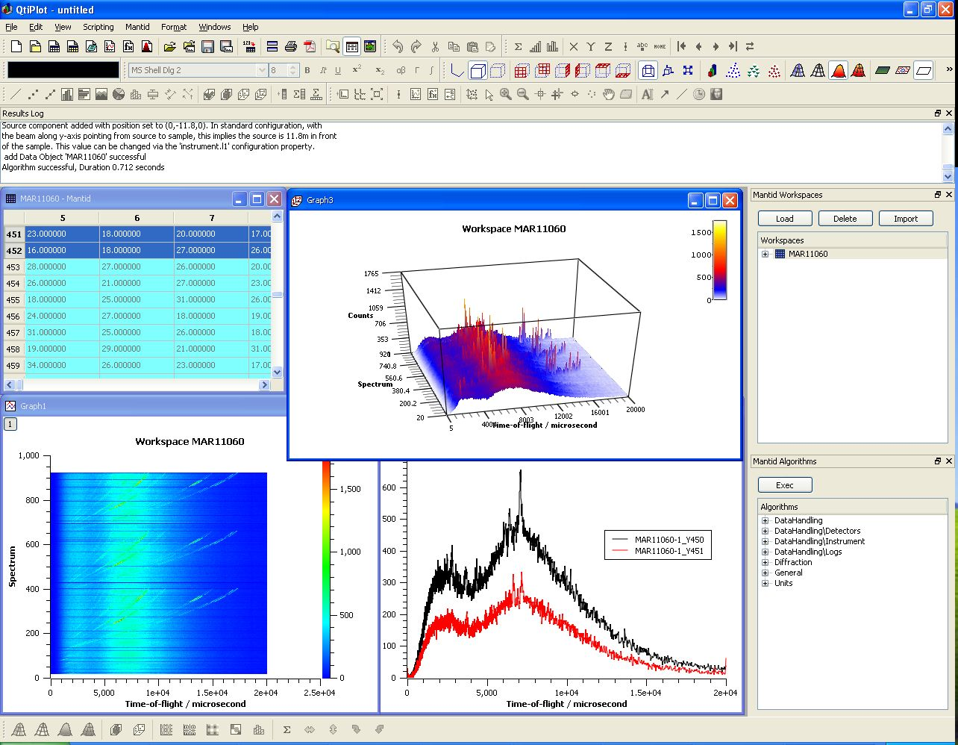
User Interfaces
Current Interfaces
  MantidPlot
    Plotting tool
    Data interaction and analysis.
    Instrument visualization
  Python
    Command line access and scripting
    Python scripting language
  Matlab Interface

Slide 9
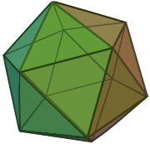

Geometry
Problem: How to maintain & visualise an accurate and fast representation of complex objects
Mesh Based
Easy, fast visualization
Poor computational accuracy & performance
Hard to define complex shapes
Surface Based
Hard, slow visualization
Good computational accuracy & performance
Easy to define objects using CSG

Slide 10
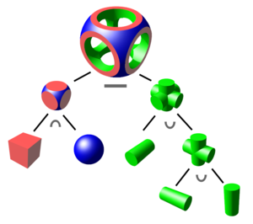


Geometry
Constructive Solid Geometry
  Building of complex shapes from
  intersections, unions and differences
  of common primitives
  Easily understood by users
Hybrid geometric model
GNU Triangulated Surface Library
Surface CSG
Used for
Definition
Calculations
Mesh
Used for
Visualization
Approximation

Slide 11

Instrument Visualisation
Instrument.exe

Slide 12
User Extensible
Doesn’t have the algorithm you need?
Add it yourself
Plugin.exe

Slide 13



Scripting
Problem: How do you write an API for algorithms you do not know about?
Solution 1: Be very generic
  mantid.exec(“LoadRaw”,”ws1;c:\myFiles\ins001.raw”)
  Not well received by users
Solution 2: Be specific – Just in time!
  LoadRaw(“ws1”,”c :\myFiles\ins001.raw”)
Mantid
Specific
API
API
Plugins

Slide 14
Future
Increased take-up by TS-1 instruments
Commissioning TS-2 instruments
Supporting larger and more complex datasets
Acceptance by the wider neutron community
Integration of Monte Carlo simulation techniques
Advanced multidimensional visualization techniques

Slide 15
Further Information
Project Web Page
  www.mantidproject.org
Project Introduction Document
  http://svn.mantidproject.org/mantid/trunk/Documents/Requirements/Project%20Introduction%20Document.doc
User Requirements Document
  http://svn.mantidproject.org/mantid/trunk/Documents/Requirements/URD.doc
Architectural Design Document
  http://svn.mantidproject.org/mantid/trunk/Documents/Design/Architecture%20Design%20Document.doc

